Slide 1
Advanced SQL Server troubleshooting with SQLCallStackResolver
Got a better name? Please let me know!
Arvind Shyamsundar
Principal Program Manager | Microsoft Azure CAT (a.k.a. SQLCAT)
Twitter: @arvisam
Blog: http://aka.ms/arvindsh
Notes:
Troubleshooting spinlock contention, strange wait types, AVs and asserts is no longer a black box. With the availability of SQLCallStackResolver (http://aka.ms/sqlstack) you can start uncovering the true reasons for a particular behavior within SQL Server, without having to open WinDbg! This tool can potentially save you a call to Microsoft Support (or at least go much better prepared to them!) In this session you will be presented live demos of how SQLCallStackResolver has helped in real-life cases, both for SQL Server on Windows and SQL Server on Linux. Latch contention, spinlock contention, AVs are no longer a mystery with this tool. Come and see how you can tackle the most difficult and advanced SQL Server troubleshooting scenarios yourself!

Slide 2

AGENDA
Target SQL scenarios
Basics
Different ways that you can collect call stacks
Why PDB symbols are important
SQLCallStackResolver basics
Installation and UI
Getting PDB symbols for specific SQL builds
Working with XEL files
Case Studies
LOCK_HASH spinlock contention
Diagnosing PAGELATCH_EX wait

Slide 3

WHY SQLCallSTACKRESOLVER?
Efficient diagnosis of difficult problems
Spinlock contention
Troubleshooting waits – overloaded wait types / “strange” wait types
Asserts / AVs
Unexplained memory allocations inside SQL
Challenges that SQLCallStackResolver addresses
Dumps are not always available
Dumps are invasive and disrupt production
XEL files (when viewed in SSMS) do not display module+offset notation (we will detail this soon!)
Scale of analysis (using WinDbg and resolving stacks manually is time-consuming)

Slide 4
Collecting Call stacks
Basic XEvent callstack action
CREATE EVENT SESSION [OOM] ON SERVER
ADD EVENT sqlserver.error_reported(
ACTION(package0.callstack) WHERE (error_number = 701 ))
ADD TARGET package0.ring_buffer WITH (STARTUP_STATE=OFF)
“Bucketizing” call stacks
CREATE EVENT SESSION XESpins ON SERVER
ADD EVENT sqlos.spinlock_backoff
(
ACTION (package0.callstack)
WHERE type = 151
)
ADD TARGET package0.histogram
(SET source_type = 1,
source = N'package0.callstack')
WITH (MAX_MEMORY = 32768 KB,
EVENT_RETENTION_MODE = ALLOW_SINGLE_EVENT_LOSS,
MAX_DISPATCH_LATENCY = 5 SECONDS,
MAX_EVENT_SIZE = 0 KB,
MEMORY_PARTITION_MODE = PER_CPU,
TRACK_CAUSALITY = OFF,
STARTUP_STATE = OFF);
Viewing data
SELECT event_session_address, target_name,
execution_count,
CAST (target_data AS XML) AS CallStack
FROM sys.dm_xe_session_targets AS xst
INNER JOIN sys.dm_xe_sessions AS xs
ON (xst.event_session_address = xs.address) WHERE xs.name = 'OOM';
Other sources for call stacks: TXT files generated whenever a dump occurs & SQL Errorlog
Notes:
XEL files can also be used as a target

Slide 5
Sample callstacks
Short Stack Dump:
00007FFBAE407057 Module(sqllang+0000000000667057)
00007FFBAE0A3088 Module(sqllang+0000000000303088)
00007FFBAE09FC6D Module(sqllang+00000000002FFC6D)
00007FFBAE484BCD Module(sqllang+00000000006E4BCD)
00007FFBAE0A1BAE Module(sqllang+0000000000301BAE)
00007FFBAE498747 Module(sqllang+00000000006F8747)
00007FFBAE6612BB Module(sqllang+00000000008C12BB)
00007FFBADDB47A0 Module(sqllang+00000000000147A0)
00007FFBADDB4203 Module(sqllang+0000000000014203)
00007FFBADDB3724 Module(sqllang+0000000000013724)
00007FFBADDBB915 Module(sqllang+000000000001B915)
00007FFBADDC0F82 Module(sqllang+0000000000020F82)
00007FFBADDC0D73 Module(sqllang+0000000000020D73)
00007FFBFF4E4EDD Module(sqldk+0000000000004EDD)
00007FFBFF4E5448 Module(sqldk+0000000000005448)
00007FFBFF4E523D Module(sqldk+000000000000523D)
00007FFBFF50C8F8 Module(sqldk+000000000002C8F8)
00007FFBFF50C9F0 Module(sqldk+000000000002C9F0)
00007FFBFF50C637 Module(sqldk+000000000002C637)
00007FFBFF50D129 Module(sqldk+000000000002D129)
00007FFC22DB1FE4 Module(KERNEL32+0000000000011FE4)
00007FFC255DEFB1 Module(ntdll+000000000006EFB1)
XEL call stack:
0x00007FFEABD0D919
0x00007FFEABC4D45D
0x00007FFEAC0F7EE0
0x00007FFEAC15CE32
0x00007FFEAC1CE596
0x00007FFEAC0F1E2A
0x00007FFEAC0F1D5A
0x00007FFEAC0F1988
0x00007FFEAC0F1A1C
0x00007FFEA99B5D1A
0x00007FFEA99B5055
0x00007FFEA99B2B8F
0x00007FFEA9675AD1
0x00007FFEA9671EFB
0x00007FFEAA37D83D
0x00007FFEAA37D241
0x00007FFEAA379F98
0x00007FFEA96719CA
0x00007FFEA9672933
0x00007FFEA9672041
0x00007FFEA967A82B
0x00007FFEA9681542

Slide 6
Making sense of call stacks
Tools to look deeper
Process Explorer (https://docs.microsoft.com/en-us/sysinternals/downloads/process-explorer)
Debugging Tools for Windows / WinDbg (https://docs.microsoft.com/en-us/windows-hardware/drivers/debugger/)
Trace flag 3656. For more information, Diagnosing and Resolving Spinlock Contention on SQL Server is highly recommended reading.
Important DLLs you might notice in call stacks
sqllang.dll; sqlmin.dll; sqldk.dll
hkengine.dll; hkruntime.dll; hkcompile.dll
To get a deeper understanding of the code / functions that are running, we need SYMBOLS!

Slide 7
We want to go from here…
… to here!
sqldk.dll+0x0000000000047645
sqldk.dll+0x0000000000001960
sqldk.dll+0x00000000000012DF
sqlmin.dll+0x000000000000187C
sqlmin.dll+0x00000000000361FE
sqlmin.dll+0x00000000000083BE
sqlmin.dll+0x000000000000861C
sqlmin.dll+0x000000000000A3D8
sqlmin.dll+0x0000000000009E96
sqlmin.dll+0x000000000000C314
sqlmin.dll+0x000000000000934D
sqlmin.dll+0x00000000000149D0
sqlmin.dll+0x00000000000DCAE2
sqlmin.dll+0x00000000000DC84B
sqlmin.dll+0x000000000018C41E
sqlmin.dll+0x000000000018B388
sqlmin.dll+0x000000000018BF6B
sqlmin.dll+0x000000000018B1A1
sqllang.dll+0x00000000002C1FFE
sqllang.dll+0x00000000002C1F5A
sqllang.dll+0x0000000000243917
sqllang.dll+0x00000000002436B7
sqllang.dll+0x00000000002C1CD2
sqllang.dll+0x00000000002C1A80
sqldk!XeSosPkg::wait_info::Publish
sqldk!SOS_Scheduler::UpdateWaitTimeStats
sqldk!SOS_Task::PostWait
sqlmin!EventInternal<SuspendQueueSLock>::Wait
sqlmin!LatchBase::Suspend
sqlmin!BUF::AcquireLatch
sqlmin!BPool::Get
sqlmin!IndexPageManager::GetPageWithKey
sqlmin!GetRowForKeyValue
sqlmin!IndexRowScanner::EstablishInitialKeyOrderPosition
sqlmin!IndexDataSetSession::GetNextRowValuesInternal
sqlmin!RowsetNewSS::GetNextRows
sqlmin!CMEDScan::DeleteNCRow
sqlmin!CMEDScan::DeleteRow
sqlmin!CMEDCatKatmaiIndex::DropRowset
sqlmin!VisibleHoBt::DropHoBt
sqlmin!SEDropRowsetInternal
sqlmin!DDLAgent::SEDropRowsets
sqllang!CIndexDDL::DropRowset
sqllang!CIndexDDL::DropAllRowsets
sqllang!DropAllRowsetsForTable
sqllang!DropObject
sqllang!FDropTempWithNolog
sqllang!TmpObject::Release
What’s our objective?

Slide 8
WHAT are (.PDB) symbols?
PDB (Program Database) files are produced by the linker at the time a DLL or EXE binary is built
These map the offsets of executable machine code in the binary to original source information (function name)
Microsoft internally stores “private PDBs” which are the full set of information including source line # information
Publicly, Microsoft “strips” out the sensitive information and makes available a “public PDB” with function name mappings and some other essential information.
PDBs are meant to be matched with their corresponding binary file – DLL or EXE. This matching is tracked via. a unique GUID (“signature”) and an “age” number.
Garbage-in; Garbage-out (“GIGO”): mismatched PDBs mean incorrect mapping to readable function names

Slide 9
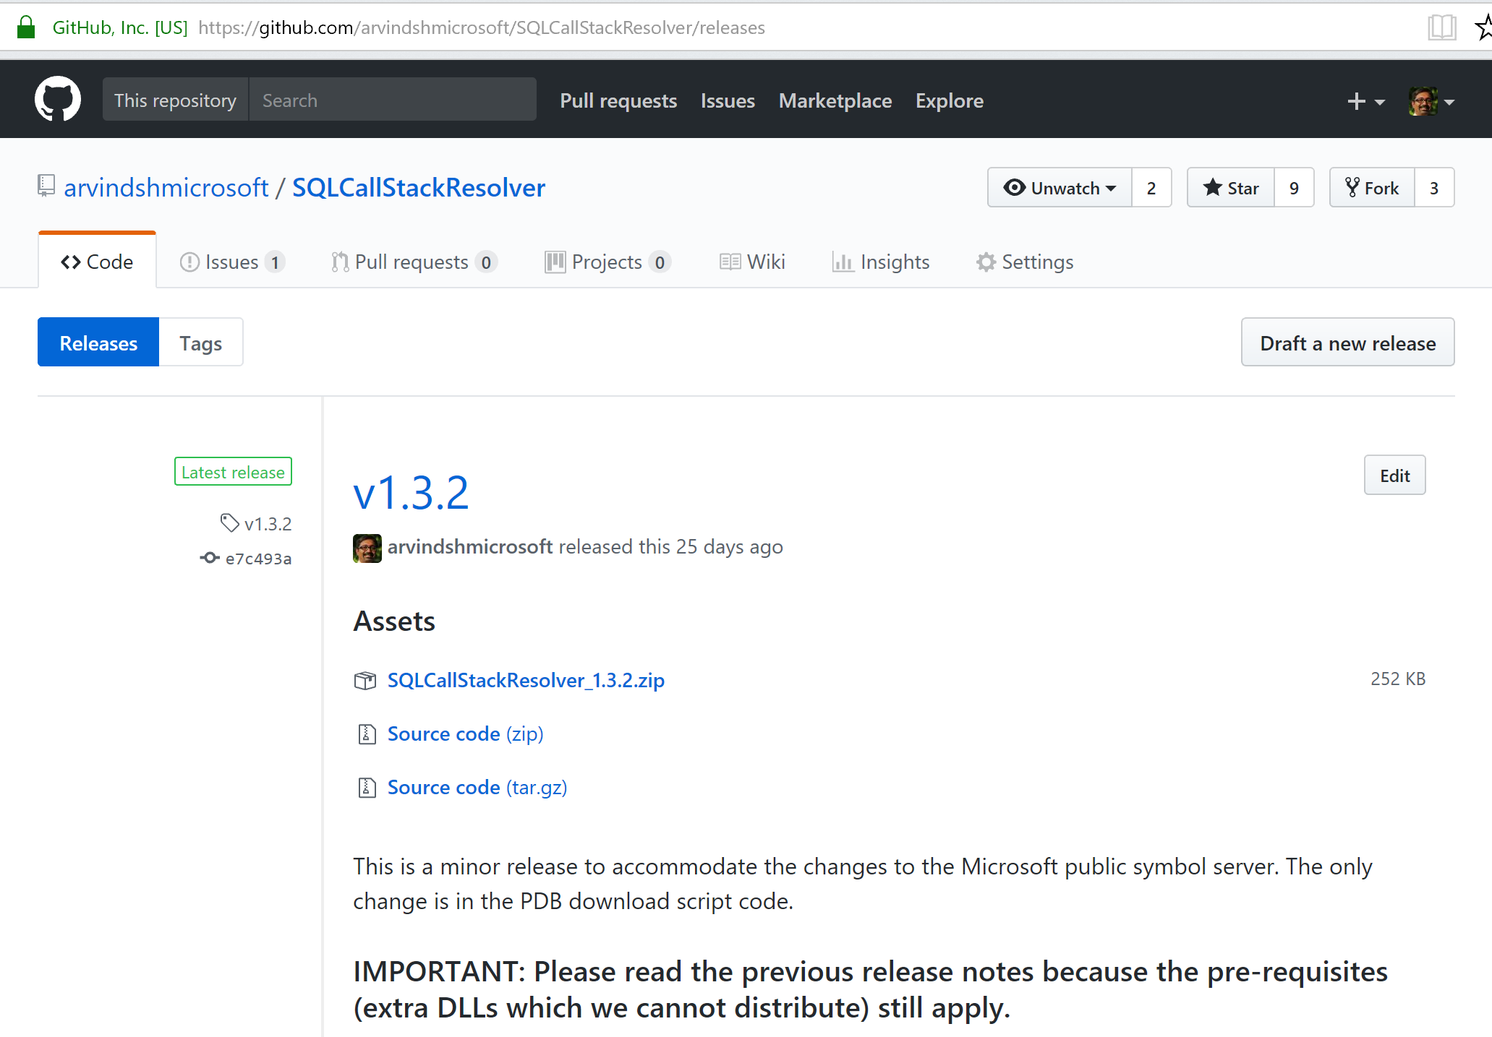
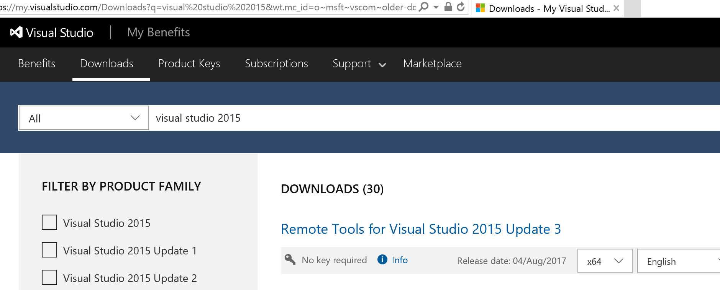
SQLCallStackResolveR: INSTALLATION
Go to https://aka.ms/SQLStack
Current release is under Releases
You need Windows and .NET Framework 4.5.2 (or greater)
Files you need to obtain manually:
MSDIA140.DLL (if you have Visual Studio 2015, you are all set, else you need the 64-bit version from https://my.visualstudio.com)
Microsoft.SqlServer.XE.Core.dll and Microsoft.SqlServer.XEvent.Linq.dll (SQL Server 2017)

Slide 10
Demo: SQLCallStackResolver UI

Slide 11
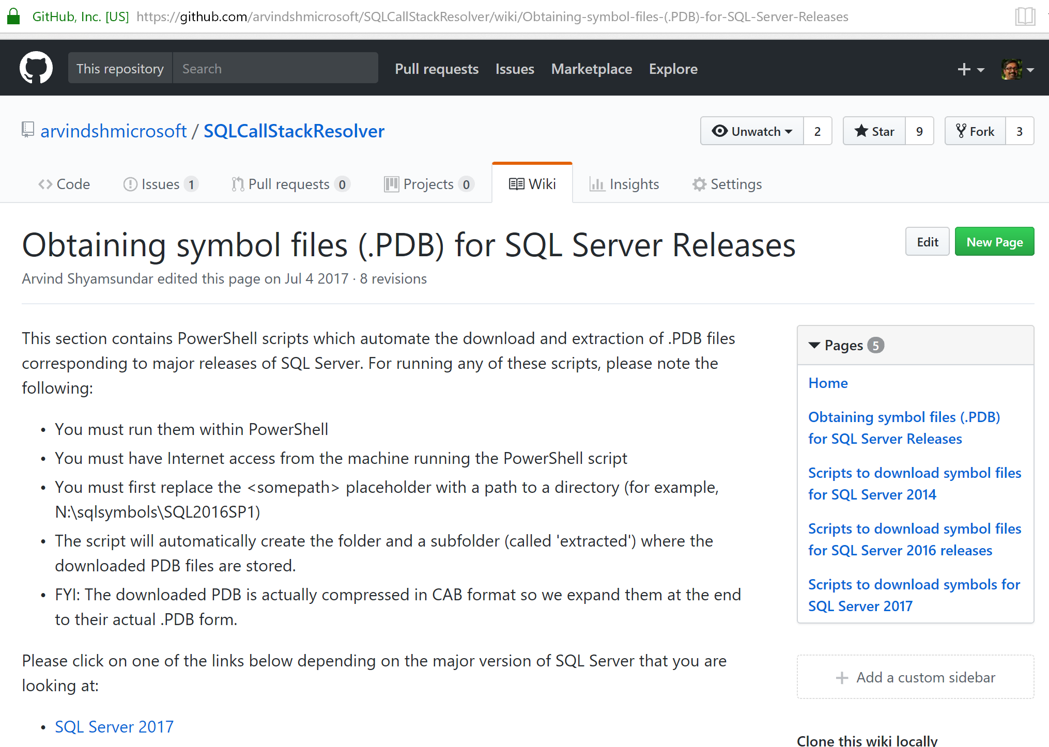
Getting matched PDB files
Go to the Wiki section under http://aka.ms/SQLStack
Locate the page corresponding to the major version of SQL Server you are troubleshooting
Most likely there’s already a script to download PDB files for the specific (including minor version for SP / CU)
Use that PowerShell script and modify the <somepath> placeholders; execute it to download the PDB files
What if there is no entry for the specific version you are using? The next demo will show you how!

Slide 12
Demo: Creating pDB download scripts

Slide 13
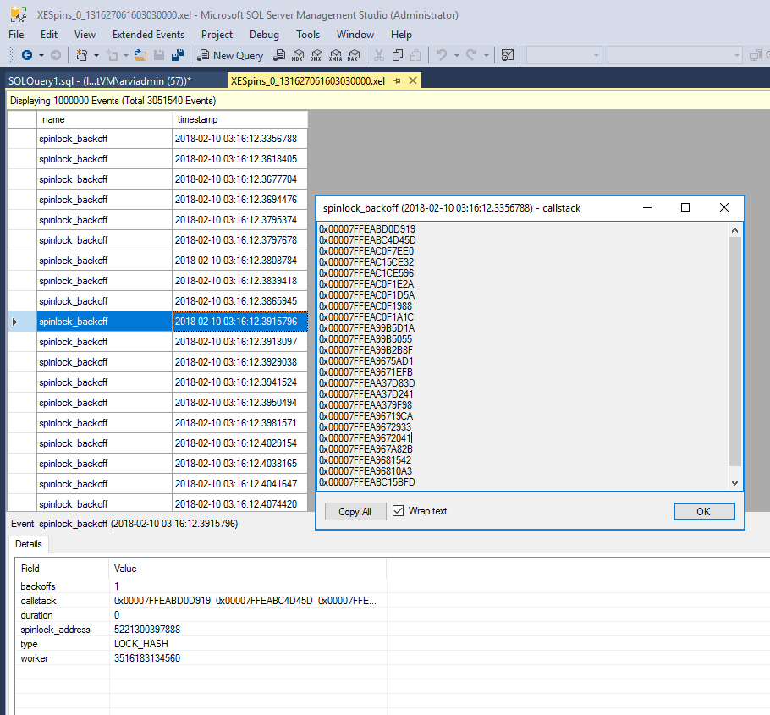
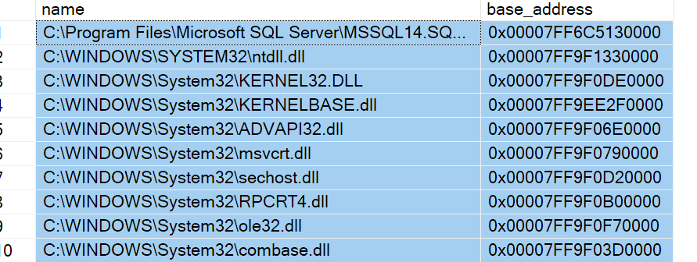
.XEL files, SSMS and call stacks
The module+offset notation for call stacks is only if you view the call stack information using a server-side method like dumping the ring buffer.
When viewed with SSMS (offline) this module+offset notation is not preserved.
SQLCallStackResolver helps in this situation!
Getting base addresses
First, run the query below within SSMS, and make sure you use Results to Grid:
SELECT name, base_address
FROM sys.dm_os_loaded_modules
Then, select ALL the results, and copy into clipboard.
Click the “Enter base addresses” in the SQLCallStackResolver tool, and OVERWRITE what’s pre-populated with the values you copied.

Slide 14
Demo: Working with XEL files

Slide 15
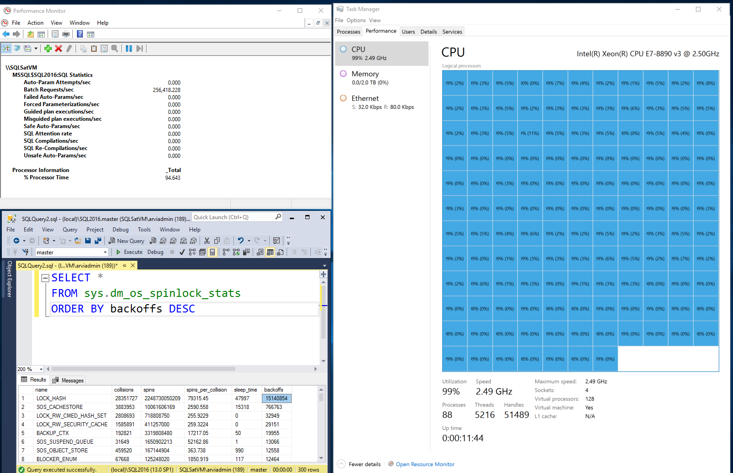
Case study: Spinlock contention
A customer was validating their workload with SQL Server 2017 (pre-release CTP) in our lab. This was a highly concurrent workload and they were seeing 100% CPU consumption on a 144-CPU box
They were using memory-optimized, non-durable tables with a natively compiled procedure and an interop stored procedure on top
The requirement was to understand the reason for the high CPU usage, and look at options for either lowering the CPU usage or to increase throughput (measured by SQL Server: Batch Requests / sec.)
Key metrics:
Azure VM with 128 vCPU
~ 250 K Batch req/sec
100% CPU usage
LOCK_HASH spinlock having huge amount of backoffs
Notes:
sys.dm_os_spinlock_stats showed the LOCK_HASH spinlock having a large number of collisions and backoffs
XPerf data collected showed over 60% of the CPU time was actually spend in this spinlock!
Collecting XE for spinlock_backoff with a histogram target showed the call stack responsible for the spinlock was associated with some metadata (MD) lookups
SELECT *
FROM sys.dm_os_spinlock_stats
ORDER BY backoffs DESC

Slide 16
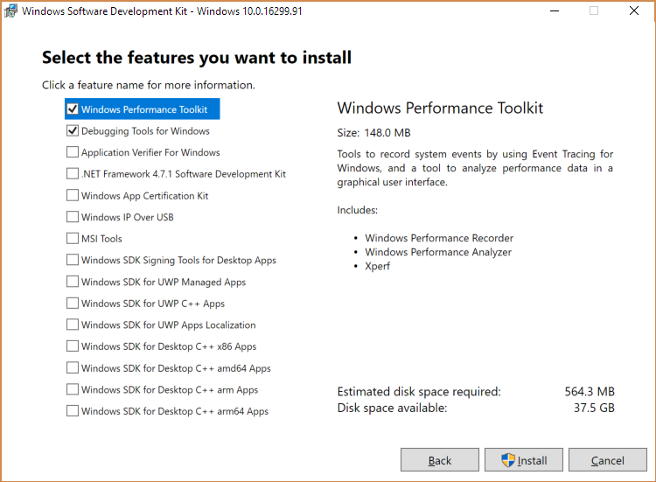
Sidebar: Xperf
Get these tools from the Windows SDK: https://developer.microsoft.com/en-US/windows/downloads/windows-10-sdk
Once downloaded on a desktop, you can copy-paste the redistributable .MSI or the folder to a server (see Notes for details)
XPerf is a command line tool for capturing traces. Capturing a basic XPerf trace for investigating high CPU usage is simple:
xperf -On Base
After a few seconds of capturing data, stop the trace and write the data out by running:
xperf -d <path to a .ETL file>
Notes:
redist for WPT is C:\Program Files (x86)\Windows Kits\10\Windows Performance Toolkit\Redistributables
redist for the Debuggers is C:\Program Files (x86)\Windows Kits\10\Debuggers\Redist

Slide 17
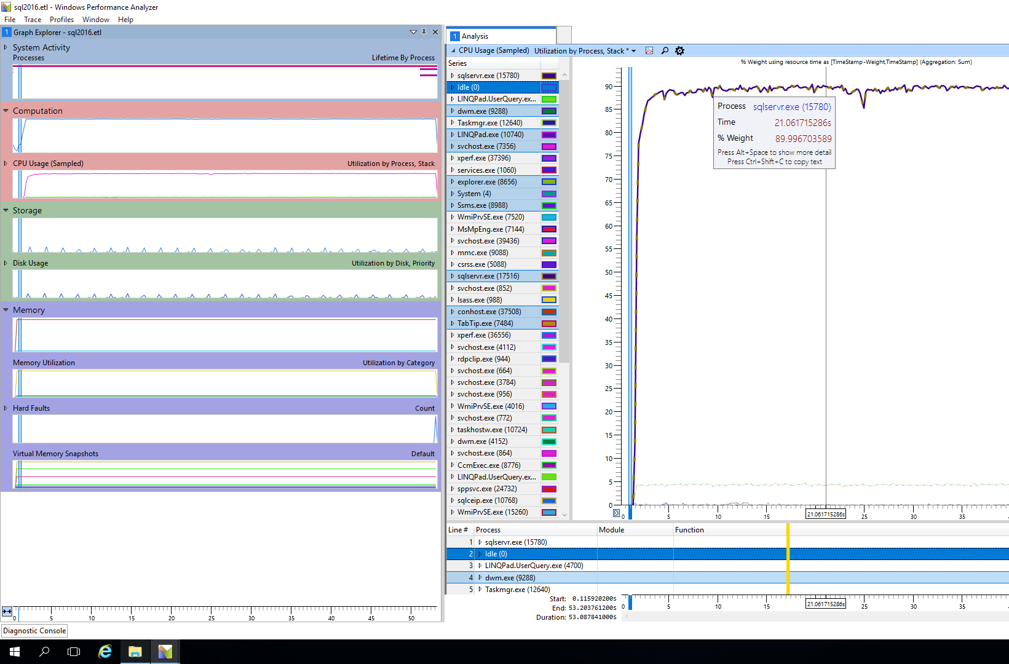
Windows perf analyzer (WPA)
WPA is also installed with the Windows Performance Toolkit
To analyze the ETL file that was saved by Xperf, open the trace in Windows Performance Analyzer (WPA)
Use the Computation view (right click and Add to Analysis view) to examine CPU usage by module and function (un-select the “Stack” option)
Make sure symbol paths are correctly setup in WPA, and the option to “Load Symbols” is turned on
Notes:
If you ever need it: redist for the Debuggers is C:\Program Files (x86)\Windows Kits\10\Debuggers\Redist

Slide 18
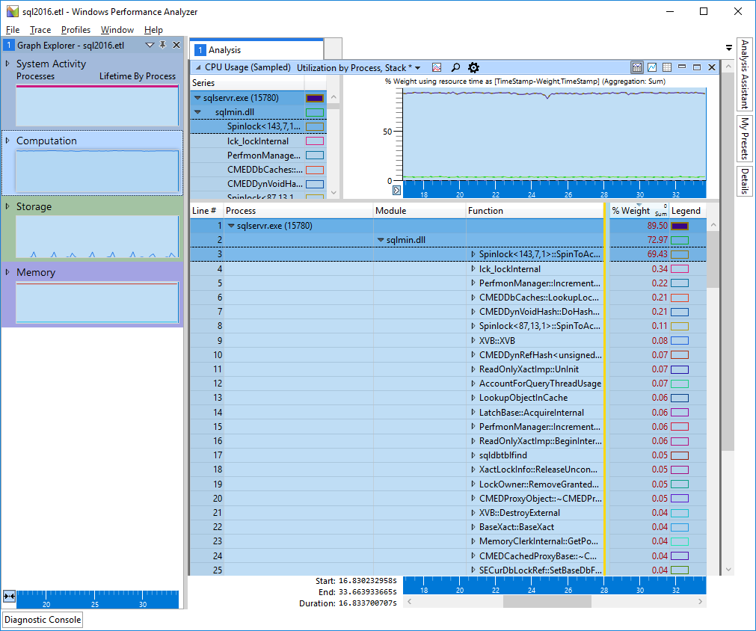
Looking at the SQL 2016 Xperf TRACE
Almost 70% of the time is spent in spins for spinlock # 143
Spinlock # 143 in SQL 2016 SP1 is LOCK_HASH (you can check this with the following query)
select * from sys.dm_xe_map_values where map_key = 143 and name = 'spinlock_types’
We still can’t tell exactly what the LOCK_HASH is due to – which is where we will look at call stacks!
Notes:
If you ever need it: redist for the Debuggers is C:\Program Files (x86)\Windows Kits\10\Debuggers\Redist

Slide 19
Demo: diagnosing LOCK_HASH Spinlock CONTENTION

Slide 20
For the record: SQL 2016 call stack
sqldk!XeSosPkg::spinlock_backoff::Publish
sqldk!SpinlockBase::Sleep
sqlmin!Spinlock<143,7,1>::SpinToAcquireWithExponentialBackoff
sqlmin!lck_lockInternal
sqlmin!MDL::LockGenericLocal
sqlmin!MDL::LockGenericIdsLocal
sqlmin!CMEDCacheEntryFactory::GetProxiedCacheEntryById
sqlmin!CMEDProxyDatabase::GetOwnerByOwnerId
sqllang!CSECAccessAuditBase::SetSecurable
sqllang!CSECManager::_AccessCheck
sqllang!CSECManager::AccessCheck
sqllang!FHasEntityPermissionsWithAuditState
sqllang!FHasEntityPermissions
…
Notes:
If you ever need it: redist for the Debuggers is C:\Program Files (x86)\Windows Kits\10\Debuggers\Redist

Slide 21
Case Study Review
Symptoms: the system was experiencing 100% CPU usage, and we wanted to know what was responsible for the high CPU usage.
DMVs showed a huge amount of LOCK_HASH spinlock contention
Using Xperf we proved that a significant % of CPU usage was attributed to the backoffs for this spinlock, hence it was worth investigating the spinlock further
To know exactly what code paths resulted in the spinlock contention (LOCK_HASH is ubiquitous / overloaded) we collected call stacks using Extended Events
We used SQLCallStackResolver to resolve those call stacks and found some likely clues:
sqlmin!CMEDProxyDatabase; sqlmin!MDL::LockGenericLocal; sqlmin!lck_lockInternal
The root cause: hash table contention for metadata (MD) locks
MD locks are not partitioned prior to SQL 2017 and hence did not scale
The SQL MD team then turned on MD lock partitioning by default in SQL 2017
This helped push the workload to much higher throughput in SQL 2017
Sidebar: LINQPad (http://www.linqpad.net) is a great tool for quick stress testing scripts!

Slide 22
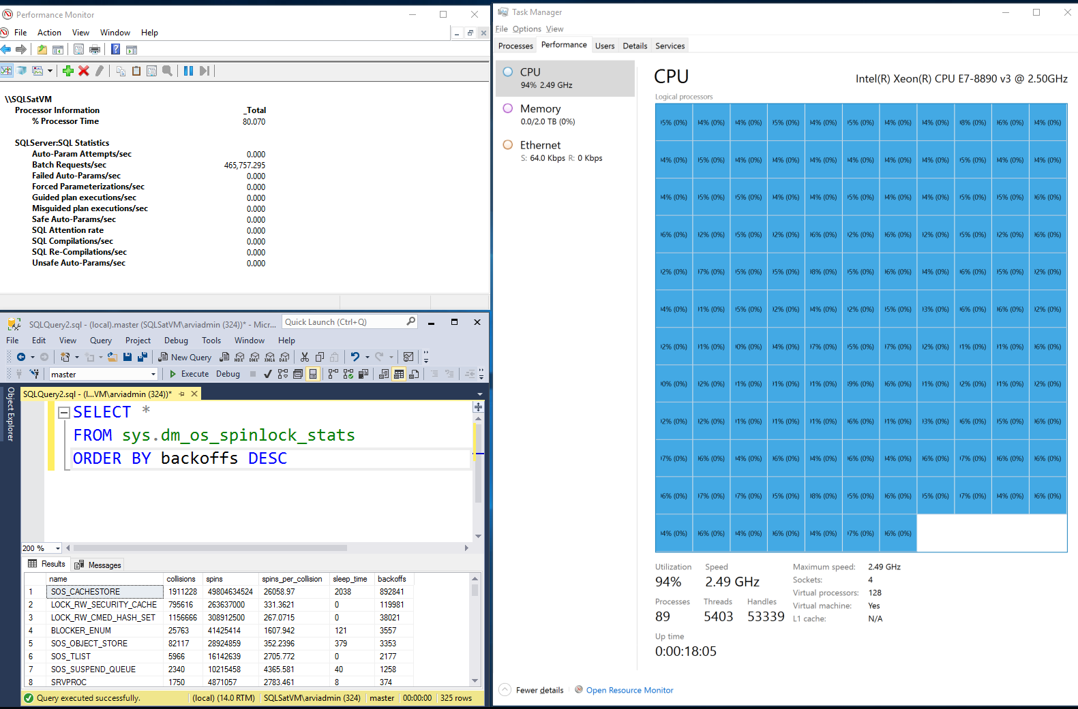
The ‘after’ PICTURE
Key metrics:
Azure VM with 128 vCPU
~ 465 K Batch req/sec
Still 100% CPU usage ☺
LOCK_HASH is gone!

Slide 23
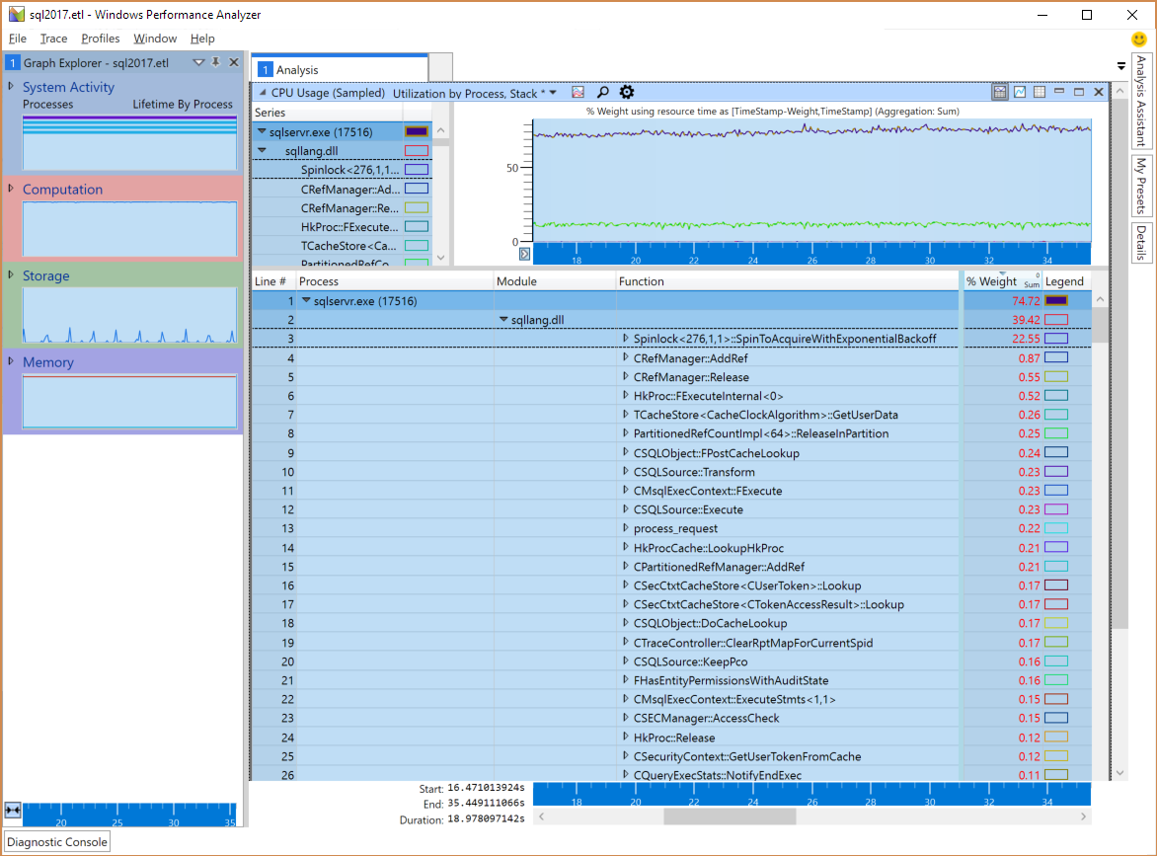
For the record: SQL 2017 Xperf Trace
We still see ~ 23% of CPU time is spent in a spinlock # 276
Spinlock # 276 in SQL 2016 RTM (verify using the below query)
select * from sys.dm_xe_map_values where map_key = 276 and name = 'spinlock_types'
Good news is that it’s not LOCK_HASH! so the fix was effective
Interestingly, the next potential bottleneck has come up (spinlock # 276 is SOS_CACHESTORE). This is a common situation in these kind of systems, where fixing one bottleneck reveals the next one.
Notes:
If you ever need it: redist for the Debuggers is C:\Program Files (x86)\Windows Kits\10\Debuggers\Redist

Slide 24
Case study: PAGELATCH_EX contention
PAGELATCH_EX contention is common with customers. In many cases this is a product of poor index selection, but in rare cases it can actually be due to sub-optimal code on the SQL engine side
One such case was observed when customers suddenly saw increased PAGELATCH_EX contention on system tables post upgrade to SQL Server 2016
Collecting callstacks for PAGELATCH_EX wait, bucketizing them into a histogram target, and then resolving them using SQLCallStackResolver clearly showed the increased waits were due to additional code introduced in SQL Server 2016
Without SQLCallStackResolver, the customer would have had to collect a dump – clearly something not acceptable given the already degraded state of performance on the box!
With the ease of isolation of the problem using SQLCallStackResolver, the SQL engineering team was able to optimize that additional code in SQL 2016 SP1 CU2 / SQL 2016 RTM CU6 (KB article: https://support.microsoft.com/kb/4013999)

Slide 25
Demo: PAGELATCH_EX contention

Slide 26
IN SUMMARY
SQLCallStackResolver is a time-saving tool to help you diagnose issues accurately
Download and install from http://aka.ms/SQLStack
Matched PDB files are the key to a successful diagnosis
For Linux, the PDBs are exactly the same as the Windows ones for the same build
For XEL files you should also have the output of sys.dm_os_loaded_modules (name, base_address) from the time the XEL was collected
Windows Performance Toolkit (XPerf / WPA) are really useful for diagnosing high CPU usage. Correlation between SQL and system performance is really important!
SQLCallStackResolver has been used successfully in real-world cases. You can use it to save time and take some guesswork out of Troubleshooting SQL!

Slide 27
THANK YOU!
Arvind Shyamsundar (@arvisam)
http://aka.ms/SQLStack

Slide 28
Extras

Slide 29
DEBUGGING SQL MEMORY
OOM / 701 errors
701 errors (“There is insufficient system memory”… ) are difficult to diagnose
Collecting XE for error_reported events with the callstack action can be very useful to shed further light on what might be happening
This in conjunction with DBCC MEMORYSTATUS, sys.dm_os_memory_* DMVs can be a comprehensive approach
Strange memory ‘leaks’
This can be very tricky to narrow down in real-world servers
One approach we have used with real-world customer issues is to collect XE for sqlos.page_allocated and sqlos.page_freed events along with the callstack action for each, and bucketize them in a histogram target
Then resolving the stacks and then manually ‘diff-ing’ the stacks actually pointed us in the right direction.

Slide 30
Demo: Investigating ERROR 701

Slide 31
DEMO: TRACKING DOWN A MEMOBJ LEAK

